Slide 1
Bank Analytics Project
Group 3

Slide 2

Data to Dashboard
Overcoming Quality and Integration Challenges in Banking Analytics.

Slide 3

Introduction - Challenges in Banking Data
Goal: Identify and solve data quality and integration challenges to build a reliable banking dashboard.
We are working with two core datasets: Client & Loan Data (static context) and Debit/Credit Transaction Data (dynamic history).
The primary hurdles lie in data cleaning, standardization, and most critically, integrating the two separate files.

Slide 4

Data Cleaning Challenges
Duplicate and Blank Headers: The Client Data has redundant column names (State Abbr) and an unnamed column, complicating the initial data load.
Extreme Sparsity: The trailing rows in the Client Data contain extensive empty cells, which can severely skew any aggregate statistics if not properly handled.
Inconsistent Date Formats: Date fields show mixed structures (e.g., MM/DD/YYYY and MM/DD/YYYY H:MM), requiring a mandatory step to convert them into a standardized datetime object for time-series analysis.
Binned Categorical Data: The Age column is stored as a range (e.g., "36-45") instead of a specific numerical value, which limits detailed correlation and regression analysis.

Slide 5
Data Cleaning Challenges
Customer Name Normalization: The Transaction Data's Customer Name field includes various honorifics (e.g., "Mr. Edgar Knight"), which must be stripped and standardized to ensure consistent matching.
Unstructured Transaction Descriptions: The Description field is free text (e.g., "Online Shopping", "Bonus Payment"). This raw data is unusable for effective dashboard filtering.
Required Categorization: The description text must be mapped to standardized categories (e.g., "Income," "Utility Bill," "Retail Spending") using either dictionary matching or basic Natural Language Processing (NLP).

Slide 6
Dashboard Parameters and Slicers
Geographic Slicers: The dashboard must include slicers for Region Name, State Name, and City to allow analysis of loan performance and transaction trends based on geographical location.
01
Transaction Type and Method Slicers: For the debit and credit dashboard, the primary slicers are Transaction Type ("Debit" vs. "Credit") and Transaction Method (e.g., "Bank Transfer," "Credit Card," "Debit Card") to isolate different types of financial movements.
02
Institution Parameters: A slicer for Bank Name is used to compare the performance and client behavior across different financial institutions.
03

Slide 7
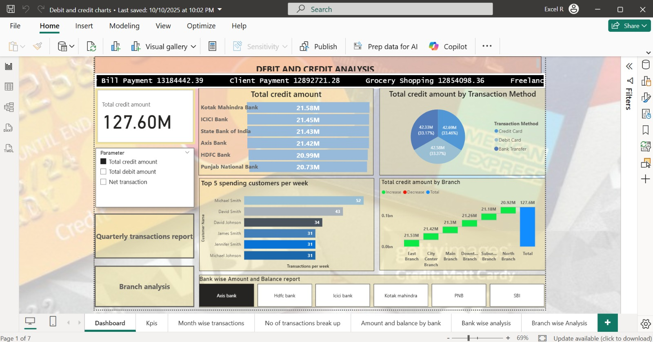
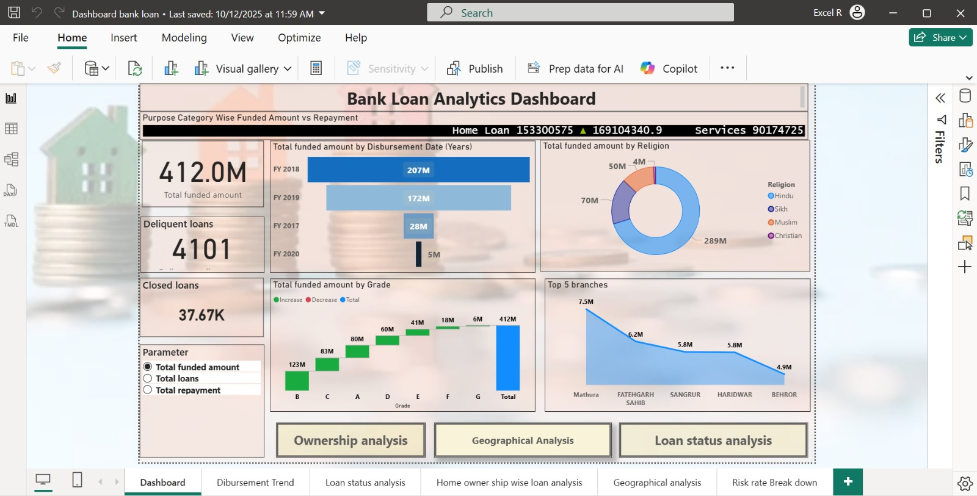
Power BI Dashboard: Summary

Slide 8
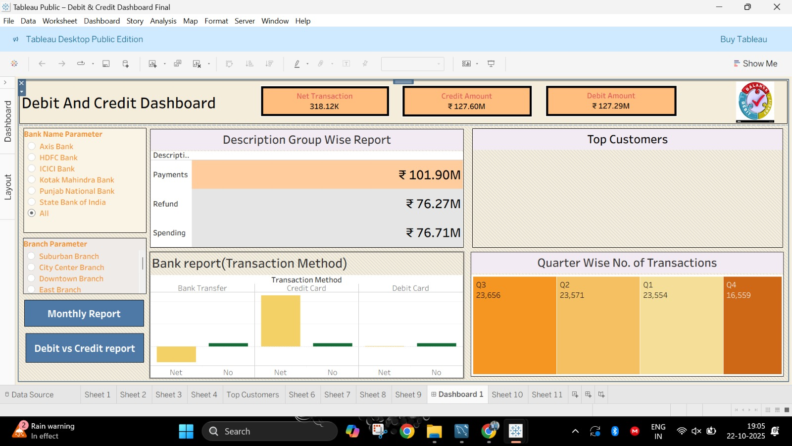
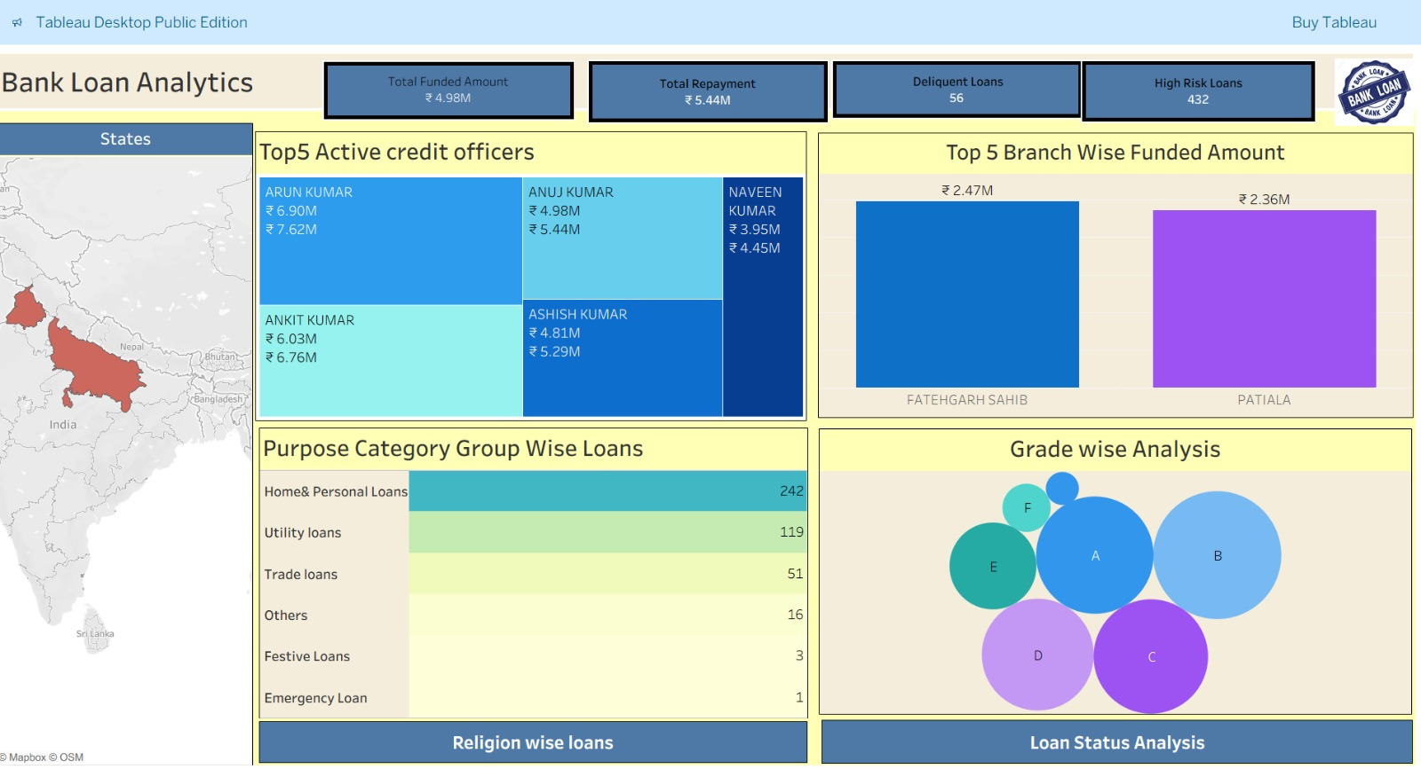
Tableau Dashboard: Summary

Slide 9
Data Categorization:
1. Categorization of Transaction Data
2. Loan Risk Categorization (By Credit Grade)
To make the unstructured Description field useful for analysis and filtering, the transactional records were categorized into three distinct, high-level groups, transforming detailed text into actionable categorical data for dashboard metrics.
Calculated Field
Risk Category =
THEN "Low Risk"
ELSE "High Risk"
END
[Grade] IN ("A", "B", "C")
WHEN
CASE

Slide 10
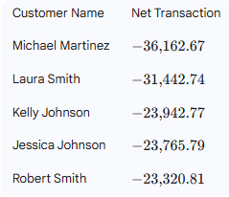
Customers having negative Net Transactions:
Key Insights:
The customer who has the most negative net transaction
is Michael Martinez.
Their total Net Transaction value (the sum of all Credits minus the sum of all Debits)
is -36,162.67.
This indicates that Michael Martinez has had the largest outflow of money compared to inflow in the recorded transaction data.

Slide 11

Bank Wise Net Transaction:
Punjab National Bank - Overall Negative Flow
Overall Performance (Total Net Transaction):
  The PNB bank has an overall negative Net Transaction balance of -897,174.48.
  This indicates that, across all branches and customers, the total outflow (Debit) from PNB accounts is significantly higher than the total inflow (Credit).
  This negative flow suggests a general trend of customers withdrawing more or receiving fewer deposits/repayments compared to their spending.

Slide 12

Thank You

